Slide 1
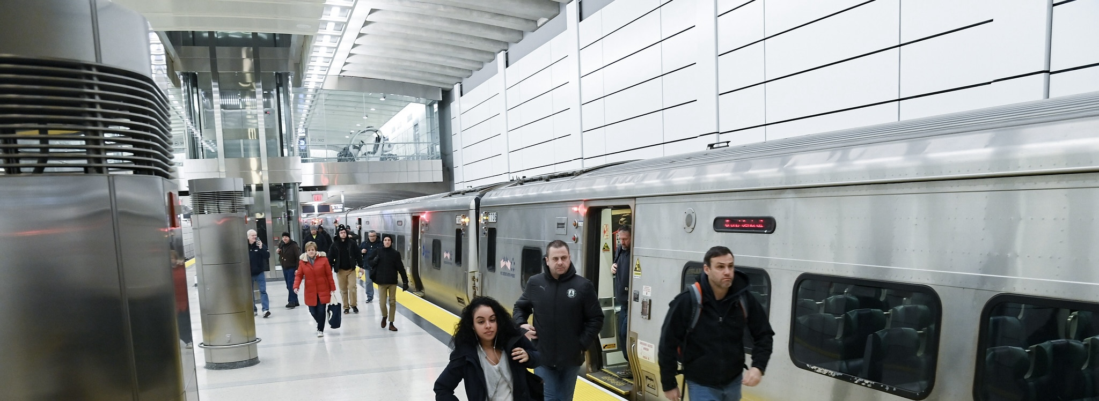



MTA
“The Metropolitan Transportation Authority”

Slide 2

Content :
Team
Introduction & project objectives
Dataset Overview
Project Building
Key Insights

Slide 3


Team Members:
1- Mohamed Fathy.
2- Mostafa Gamal.
3- Zenib Ibrahim.
4- Hazem.
5- Esraa ElMalawy.
6- Abanob Samir.

Slide 4
Introduction
The Metropolitan Transportation Authority (MTA) is the largest transit network in North America.
It serves 12 counties in southeastern New York and 2 in Connecticut. Includes subway, bus, commuter rail, paratransit, and bridges/tunnels.

Slide 5


Project Objective
Analyze MTA ridership trends pre- and post-pandemic.
Identify recovery patterns and peak ridership times.
Provide insights for future transportation planning.

Slide 6

Dataset Overview
MTA Daily Ridership Data (CSV) Contain Comparison between Pre-pandemic vs. Post-pandemic ridership for:
- Subway (NYCT)
- Buses ( MTABC)
- Long Island Rail Road (LIRR)
- Metro-North Railroad (MNR)
- Bridges and Tunnels (B&T)
- Staten Island Railway (SIR)
NYC COVID-19 Cases ( XLSX)
Ticket Revenue Data (XLSX)

Slide 7
Dataset Overview
Data Collection Methodology:
Subway and bus ridership data from MetroCard/OMNY transactions.
LIRR and Metro-North ridership is estimated by a model using monthly, weekly, ten-trip, and daily ticket sales.
The Access-A-Ride ridership within this dataset is a measure of scheduled trips as an indicator of demand
Bridges and Tunnels data comprises of preliminary total traffic volume collected by the toll collection systems at the 7 MTA bridge and 2 tunnel crossings.

Slide 8
Project Building
1- Data Cleaning steps:
Loaded data from multiple sources.
Removed duplicate and unnecessary columns.
Handled missing values.
Formatted date and numerical fields.
Created calculated columns for analysis
Standardized date and time formats.
2- Data modeling for power bi steps:
Created new calculated fields using DAX
Created relation between tables
2- Visuals :

Slide 9

Project Building
3- Visuals :
Line Charts – Showed ridership trends over time.
Bar Charts – Compared different MTA services.
KPI Cards – Highlighted key statistics.
Pie charts.
Callender.
Slicers.
Multicard

Slide 10
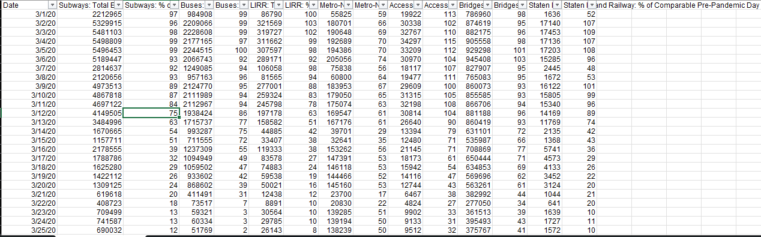
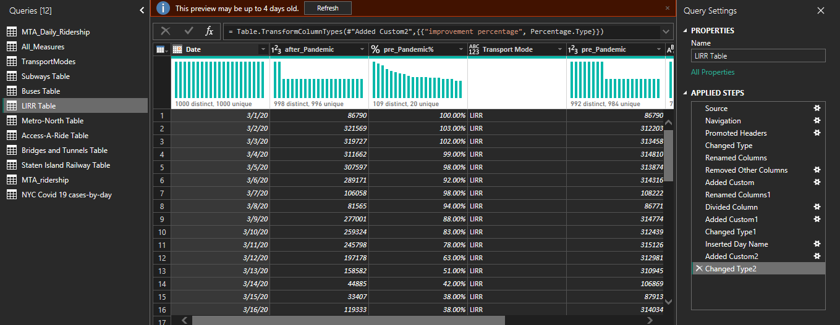
Project Building: 1- Data Cleaning & modeling
1- Data Cleaning
2- Table Cutting
3- Create Column
4- Create Measures
5- Creating relations

Slide 11
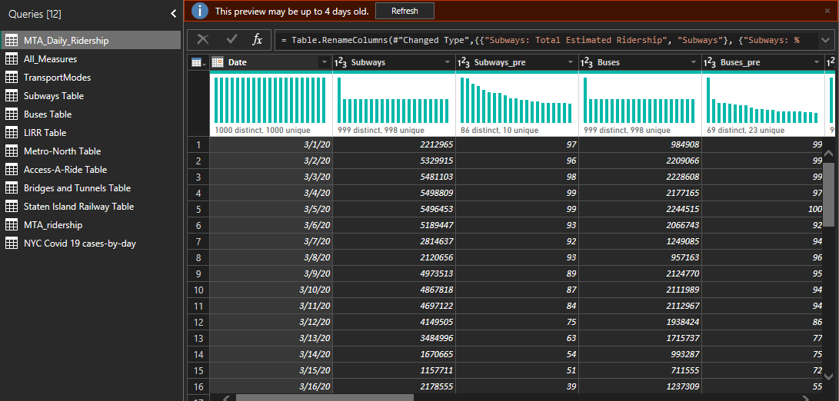
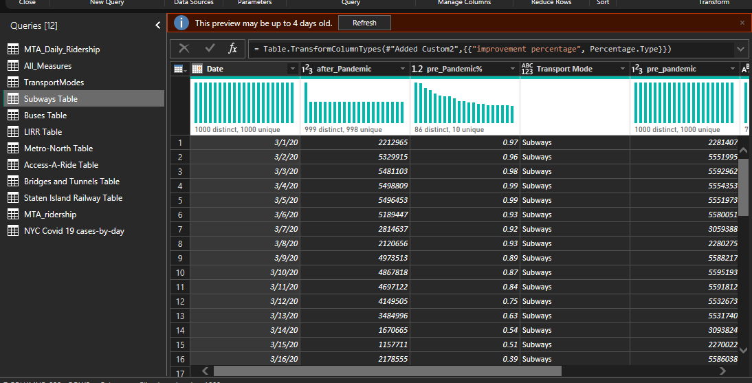
Project Building: 1- Data Cleaning & modeling
1- Data Cleaning
2- Table Cutting
3- Create Column
4- Create Measures
5- Creating relations

Slide 12
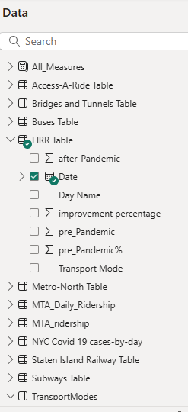
Project Building: 1- Data Cleaning & modeling
1- Data Cleaning
2- Table Cutting
3- Create Column
4- Create Measures
5- Creating relations

Slide 13
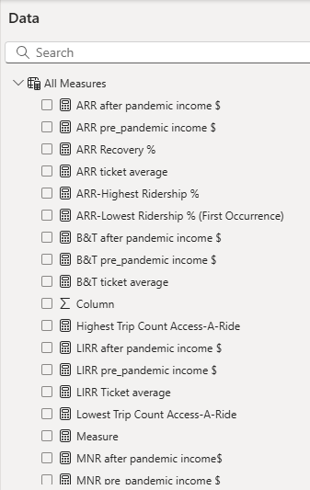
Project Building: 1- Data Cleaning & modeling
1- Data Cleaning
2- Table Cutting
3- Create Column
4- Create Measures
5- Creating relations

Slide 14
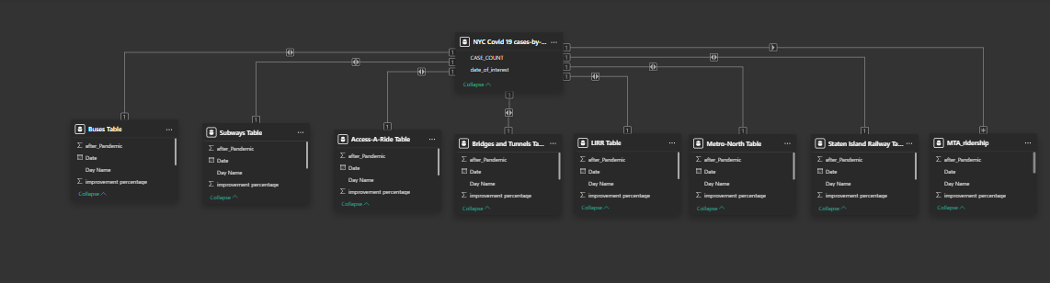
Project Building: 1- Data Cleaning & modeling
1- Data Cleaning
2- Table Cutting
3- Create Column
4- Create Measures
5- Creating relations

Slide 15


Project Building: 3- Visuals (main+7 Visuals)
B&T
NYCT
LIRR
ARR
MTABC
SIR
MNR

Slide 16
B&T
NYCT
LIRR
B&T
ARR
MTABC
SIR
MNR

Slide 17
B&T
NYCT
LIRR
B&T
ARR
MTABC
SIR
MNR

Slide 18
B&T
NYCT
LIRR
B&T
ARR
MTABC
SIR
MNR

Slide 19
B&T
NYCT
LIRR
B&T
ARR
MTABC
SIR
MNR

Slide 20
B&T
NYCT
LIRR
B&T
ARR
MTABC
SIR
MNR

Slide 21
B&T
NYCT
LIRR
ARR
MTABC
SIR
MNR

Slide 22
services
history
teams
B&T
timeline
ARR
MTABC
NYCT
MNR
SIR
LIRR

Slide 23
services
history
teams
B&T
timeline
ARR
MTABC
NYCT
MNR
SIR
LIRR

Slide 24
services
history
teams
B&T
timeline
ARR
NYCT
MNR
MTABC
SIR
LIRR

Slide 25
services
history
teams
B&T
timeline
ARR
NYCT
MNR
MTABC
SIR
LIRR

Slide 26
services
history
teams
ARR
B&T
NYCT
timeline
MTABC
MNR
SIR
LIRR

Slide 27
services
history
teams
ARR
B&T
NYCT
timeline
MTABC
MNR
SIR
LIRR

Slide 28
services
history
teams
B&T
timeline
ARR
NYCT
MNR
MTABC
SIR
LIRR

Slide 29
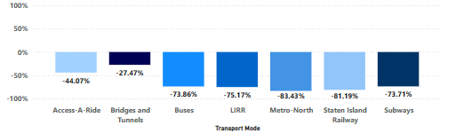
Key Insights from the MTA for year 2020
In 2020, MTA experienced a decline in ridership across all six subsidiaries, as well as in the ARR service. The least affected company was MTA B&T, which is understandable due to the COVID-19 pandemic. People relied more on private transportation to reduce the spread of the virus, avoiding public transit options such as buses and subways.

Slide 30
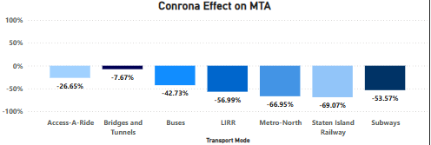
Key Insights from the MTA for year 2021
In 2021, all services showed a clear gradual improvement with the beginning of the decline in the spread of the COVID-19 virus.

Slide 31
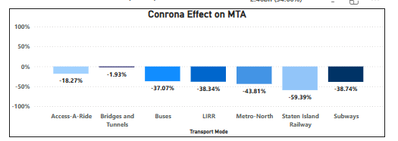
Key Insights from the MTA for year 2022
In 2022, all services showed a clear gradual improvement from 2021 with the beginning of the decline in the spread of the COVID-19 virus.

Slide 32
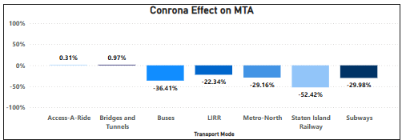
Key Insights from the MTA for year 2023
In 2023, all services showed a clear gradual improvement with the beginning of the decline in the spread of the COVID-19 virus. And ARR & B&T are achieving positive improvement after three years of loss.

Slide 33
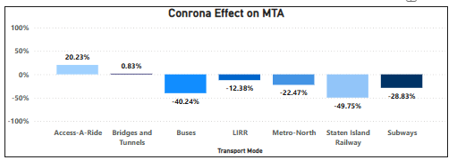
Key Insights from the MTA for year 2024
In 2024, all services showed a slight positive improvement. But Buses & B&T slightly decreased in improvement

Slide 34
Thanks
We would like to express our sincere gratitude to DEPI for managing and presenting these valuable courses, providing us with an excellent learning experience.
A special thanks to CLS for their support in providing skilled instructors who have guided us throughout the training.
Most importantly, We extend our deepest appreciation to Instructor Wael Gomaa for his dedication, expertise, and insightful teaching, which have significantly enriched our knowledge. Your efforts are truly appreciated, and we are grateful for this opportunity to learn and grow. Thank you!

Slide 35
Thank You

